Slide 1
ISM 6404 Project: NBA Players Analysis
AUTHOR: David Heller

Slide 2
Dataset
Dataset was selected from Kaggle.com
Timeframe: 1996 - 2022
Number of instances: 12,306
Number of attributes: 21
Including Player name, Team, Player height, Player weight, College, Nationality, Draft year, Draft round, Draft number, Games played, Points, Rebounds, season, among others.

Slide 3
Questions to Explore
How does the relationship between points and rebounds vary among NBA players?
What is the distribution of player ages in the NBA?
How do the points per game of individual players change over their careers?
How does player height vary across different NBA teams?
Which NBA team has the highest average points per game in a specific season?
What is the distribution of player nationalities across NBA teams?
How does the average points per game of players vary based on their draft round and season?
Which college has produced the most NBA draftees?
Is there any correlation between draft round and average rebounds per game for players?

Slide 4
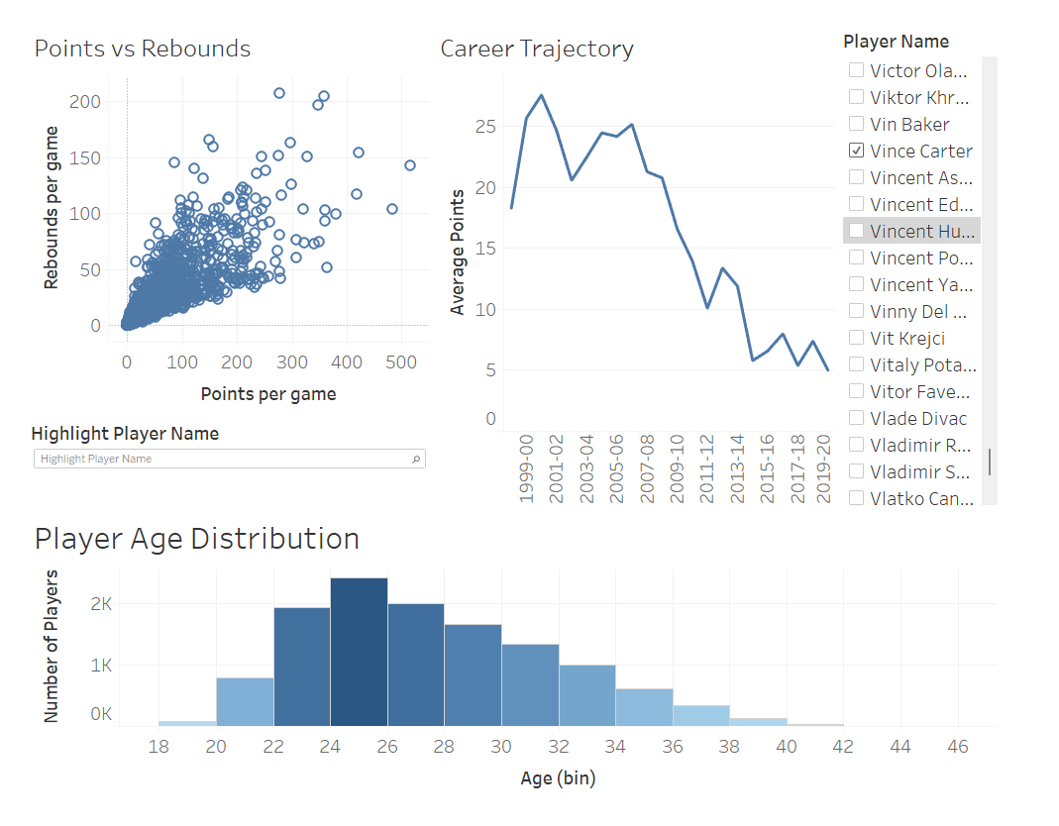
Dashboard 1: Player Performance

Slide 5
Dashboard 1 Analysis
Our first dashboard offers a closer look at player performance within the NBA. Here, we examine the intricate relationship between points scored and rebounds gathered per game. By visualizing this data in a scatter plot, we aim to identify any notable correlations or patterns that may emerge, providing valuable insights into the dynamics of player contributions on the court.
Additionally, we explore the age distribution of NBA players through a histogram, shedding light on the demographic makeup of the league. This analysis allows us to understand the age diversity within NBA teams and potentially identify any trends or anomalies.
Finally, we present a line graph showcasing the career trajectories of individual players, with the x-axis representing seasons and the y-axis representing average points per game. By enabling users to filter by player, we offer a dynamic tool for tracking player development over time, uncovering insights into career progression and performance consistency.

Slide 6
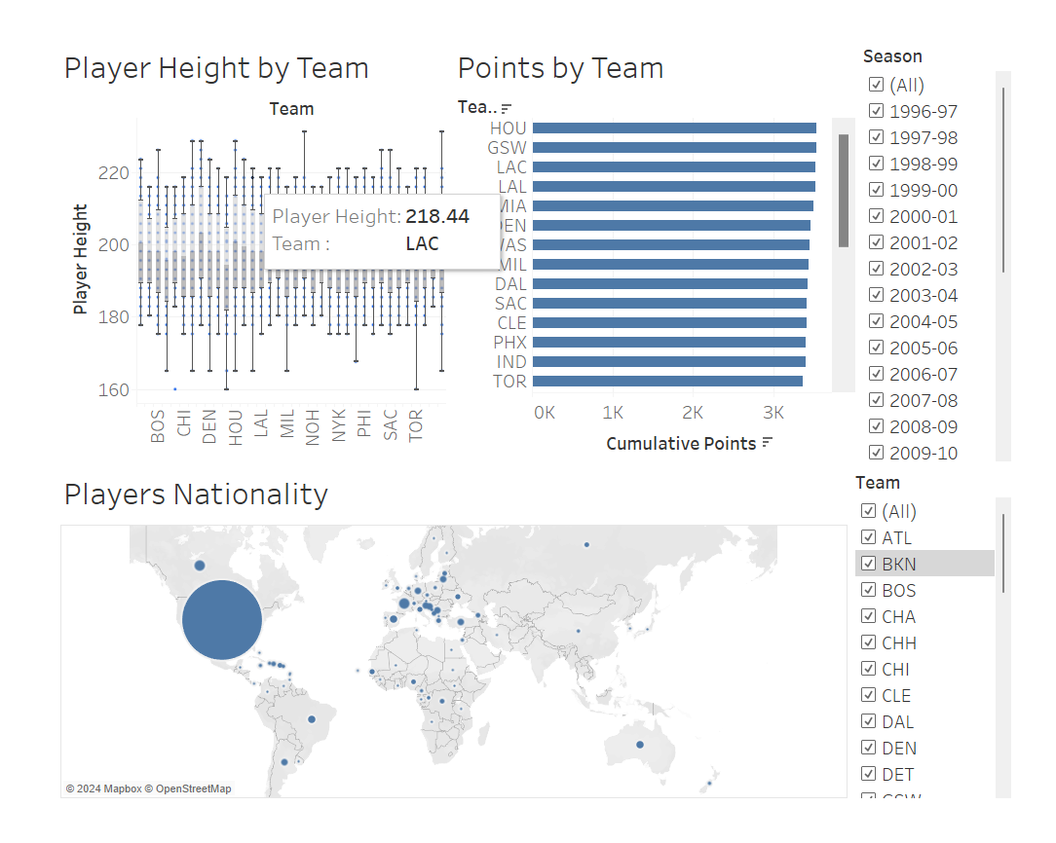
Dashboard 2: Team Statistics

Slide 7
Dashboard 2 Analysis
Our second dashboard shifts the focus to team statistics, providing insights into the collective performance and characteristics of NBA teams. We start by exploring player height distributions across teams through a box plot visualization. By examining the variation in player heights within each team, we gain insights into team dynamics and potential strategic advantages or challenges.
Next, we delve into the scoring prowess of NBA teams by visualizing average points per game across seasons in a bar chart. With the ability to filter by season, users can identify trends in team performance over time and assess the offensive capabilities of different teams.
Lastly, we present a geographical analysis of player nationalities across NBA teams through an interactive map. By visualizing the distribution of player nationalities and adjusting the map based on team selection, we offer insights into the global diversity within NBA rosters and potential implications for team cohesion and international scouting efforts.

Slide 8
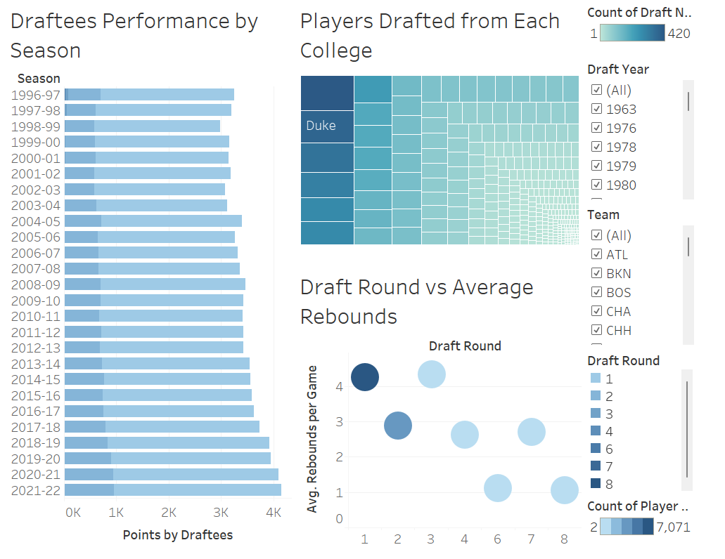
Dashboard 3: Draft Analysis

Slide 9
Dashboard 3 Analysis
Our final dashboard focuses on draft analysis, exploring the process of talent acquisition and player development within the NBA. We begin by examining the average points per game of NBA players based on their draft round and the season they were drafted. Through a bar plot visualization with color-coded draft rounds, we aim to uncover trends in player performance relative to their draft position, providing insights into the efficacy of scouting and drafting strategies.
Next, we investigate the collegiate pipeline to the NBA by visualizing the number of players drafted from each college in a tree map. With the ability to filter by team and season, users can identify colleges that have historically produced the most NBA draftees, offering valuable insights into recruiting hotbeds and collegiate player development programs.
Finally, we present a bubble graph showcasing the relationship between draft round and average rebounds per game. By visualizing the average rebounds per game of players drafted in each round, we aim to identify any correlations or trends that may exist between draft position and player performance in this key statistical category.

Slide 10
Conclusion
Our analysis of the NBA Players dataset using Tableau has successfully addressed the explanatory questions guiding our exploration. Leveraging Tableau's visual analytics tools and the methods learned in class, we've gained valuable insights into player performance, team dynamics, and draft trends within the NBA.
Through visualizations, we've examined the relationship between points and rebounds among NBA players, observed the distribution of player ages, and tracked individual players' career trajectories in terms of points per game. We've also analyzed team statistics, including player height variations across teams and the average points per game by team and season.
Furthermore, our exploration has provided insights into the geographical distribution of player nationalities across NBA teams and identified trends in draft picks' performance based on draft round and season. Overall, our analysis has helped us better understand the intricacies of the NBA and its players, highlighting the value of Tableau as a powerful tool for sports analytics.

Slide 11
Project Presentation
Link to recorded presentation: Project Presentation
Please notice that you need an FIU account to watch it.

